Slide 1


BANK ACCOUNT SIMULATION USING C

Slide 2
Our Team
Yash Shahane (1262252671)
Samarth Talegaonkar (1262251988)
Pranav Unde (1262253863)
Pushkar Pathare (1262252053)

Slide 3
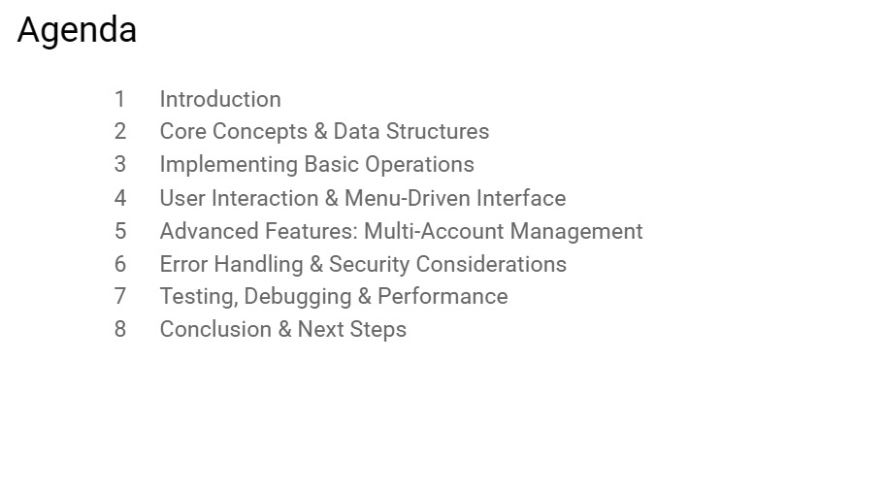
Agenda
Introduction
Core concepts & Data Structures
Implementing Basic Operations
User Interaction & Menu-Driven Interface
Advanced Features: Multi-Account Management
Error Handling & Security Considerations
Testing, Debugging & Performance
Conclusion & Next Step

Slide 4
Why simulate a bank account in C?
• Motivation behind the simulation:
Modeling a bank account in C offers a sandbox for reasoning about monetary state, transaction atomicity, and error propagation without the regulatory overhead of real banking systems.
• Learning outcomes:
Participants will master the definition of composite data types, direct memory handling, console I/O, and systematic unit testing, laying a foundation for embedded finance applications.
• C as the language of choice:
C’s deterministic execution model, fine-grained control over data layout, and minimal runtime make it ideal for high-frequency, low-latency financial kernels that must run on constrained hardware.

Slide 5
Core Concepts & Data Structures
Designing the Account abstraction
• Account struct blueprint:
A compact aggregate type housing an integer identifier, a double-precision balance, and a fixed-size character array for the account holder, enabling contiguous storage and predictable offset calculations.
• Constants and macros for safety:
Preprocessor symbols such as MAX_ACCOUNTS, MIN_BALANCE, and OVERFLOW_THRESHOLD encode business rules at compile time, allowing the compiler to inline checks and reducing runtime branching.
• Operation signatures:
Prototype declarations for deposit, withdraw, and query functions convey intent, enforce type safety, and decouple implementation from the calling context, facilitating unit testing and future refactoring.

Slide 6
Implementing Basic Operations
Deposit, withdraw, and query mechanics ➕ Deposit routine
Validates a positive amount, checks that the addition will not surpass the defined overflow guard, then atomically updates the balance while returning a status code.
➖ Withdrawal routine
Ensures the requested debit does not exceed the available balance, guards against underflow, and logs an error code for insufficient funds without mutating the state.
👁 Balance inquiry
Provides read-only access to the current balance, formatting the monetary value with two decimal places and a currency symbol for a clean console display.

Slide 7
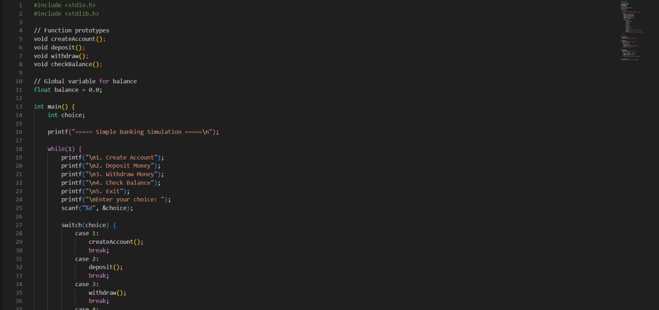

Slide 8
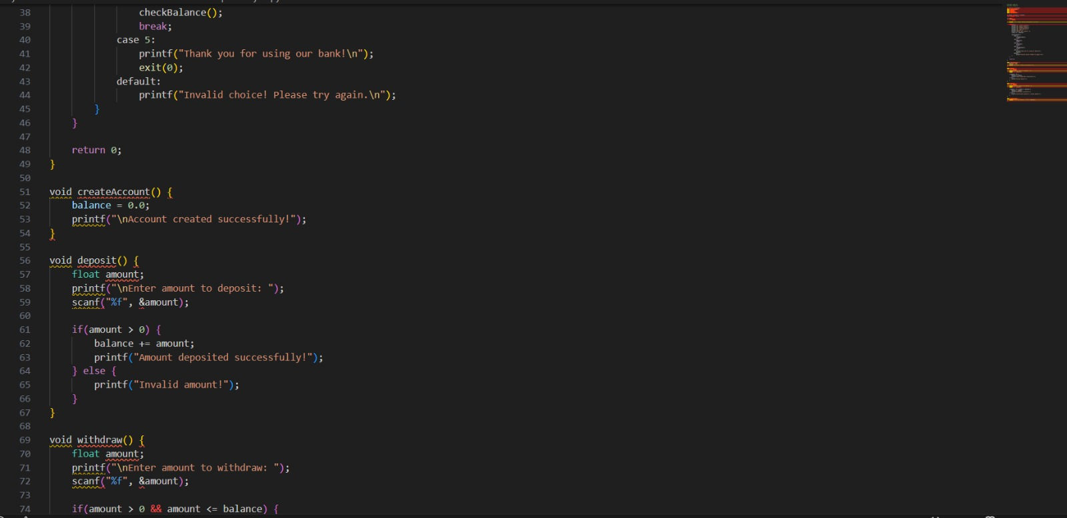

Slide 9
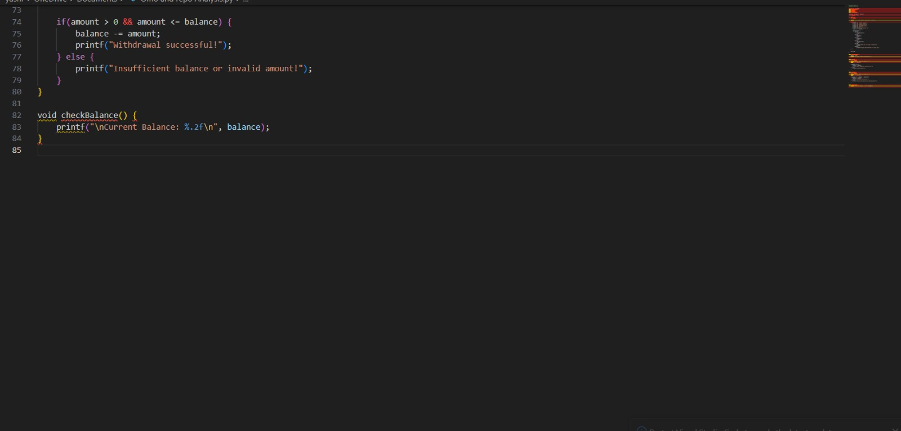

Slide 10
User Interaction & Menu-Driven Interface
Building a responsive CLI
• Persistent menu loop:
A while(1) construct presents options repeatedly, delegating the user’s choice to a switch statement that dispatches to the appropriate account operation.
• Robust input handling:
scanf results are inspected; any mismatch triggers an input buffer flush and a user-friendly retry prompt, preventing undefined behaviour from malformed data.
• CLI polish:
Platform-agnostic screen clearing (e.g., system("clear") on Unix) and a pause routine using getchar() deliver a smooth, interactive experience without resorting to non-standard libraries.

Slide 11
Error Handling & Security Considerations
Defending against invalid operations Overflow and underflow detection
Before any arithmetic, the code compares operands against INT_MAX/INT_MIN or uses __builtin_add_overflow to guarantee that the result stays within legal bounds.
Input sanitisation
All numeric entries are bounded by explicit range checks; string inputs are limited by sizeof buffers and read with fgets instead of unsafe gets.
Secure I/O alternatives
Rather than relying on fflush(stdin), the program discards residual characters with a loop reading until a newline, eliminating undefined behaviour on non-POSIX platforms.

Slide 12
Testing, Debugging & Performance
Unit testing framework
Simple test harness feeds predetermined inputs to deposit/withdraw functions and asserts expected balances, automating regression checks after each code change.
Ensuring correctness and efficiency
Dynamic analysis with gdb and Valgrind
Step-through debugging isolates logical faults, while Valgrind’s memcheck flags leaks, illegal reads, and uninitialized memory accesses.
Performance benchmarking
Chronometric loops execute bulk deposits on large account arrays, measuring CPU cycles with clock_gettime to highlight algorithmic scalability and cache effects.

Slide 13
Conclusion & Next Steps
From prototype to production-grade system
• Implementation recap:
We have built a modular, well-documented C codebase that models accounts, enforces financial invariants, and provides a clean command-line interface.
• Future expansion paths:
Potential upgrades include a graphical front-end (e.g., using GTK), persistent storage via binary files or SQLite, and networking to expose the account engine as a microservice.
• Best-practice guidelines:
Emphasize separation of concerns, comprehensive commenting, and the use of header files to expose only essential interfaces, facilitating future extensions.

Slide 14
THANK YOU

